Slide 1
Trees and its variations
Presentation for use with the textbook Data Structures and Algorithms in Java, 6th edition, by M. T. Goodrich, R. Tamassia, and M. H. Goldwasser, Wiley, 2014
Mammal
Dog
Pig
Cat

Slide 2
Abstract Data Type (ADT)
An abstract data type (ADT) is an abstraction of a data structure
An ADT specifies:
Data stored
Operations on the data
Error conditions associated with operations
Linear ADT: the elements form a sequence. Examples: Array ADT, List ADT, Queue ADT
Non-linear ADT: elements do not form a sequence. Example: Trees

Slide 3

A Hierarchical Structure

Slide 4
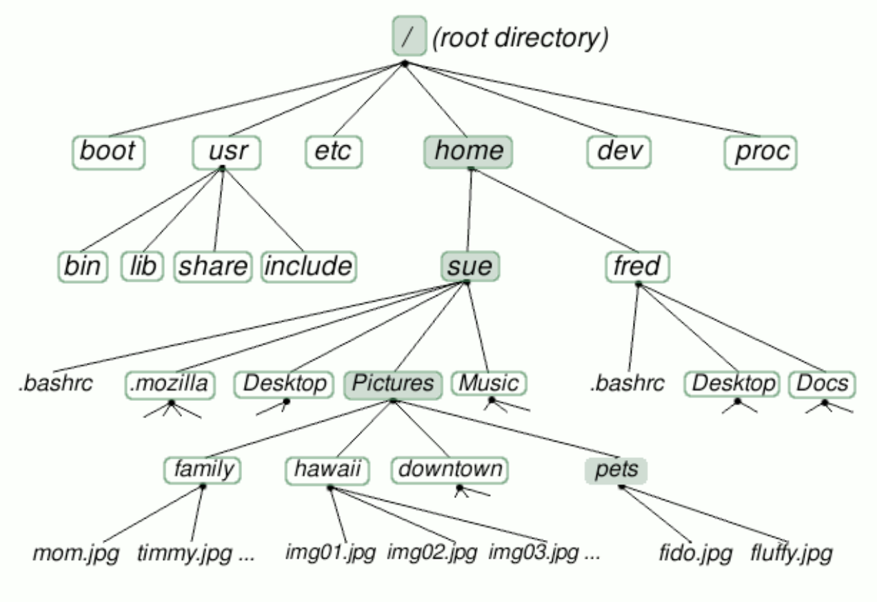
Linux/Unix file systems

Slide 5
Tree: A Hierarchical ADT
A tree (upside down) is an abstract model of a hierarchical structure
A tree consists of nodes with a parent-child relation
Each element (except the top element) has a parent and zero or more children elements
Computers”R”Us
Sales
Manufacturing
R&D
US
International
Laptops
Desktops
Europe
Asia
Canada

Slide 6
Tree Terminology
Root: node without parent (A)
Internal node: node with at least one child (A, B, C, F)
External node (a.k.a. leaf ): node without children (E, I, J, K, G, H, D)
Subtree: tree consisting of a node and its descendants
A
subtree
B
C
D
E
F
G
H
I
J
K

Slide 7
Tree Terminology
Ancestors of a node: parent, grandparent, grand-grandparent, etc.
Depth of a node: number of ancestors
Height of a tree: maximum depth of any node
Descendant of a node: child, grandchild, grand-grandchild, etc.
A
subtree
B
C
D
E
F
G
H
I
J
K

Slide 8
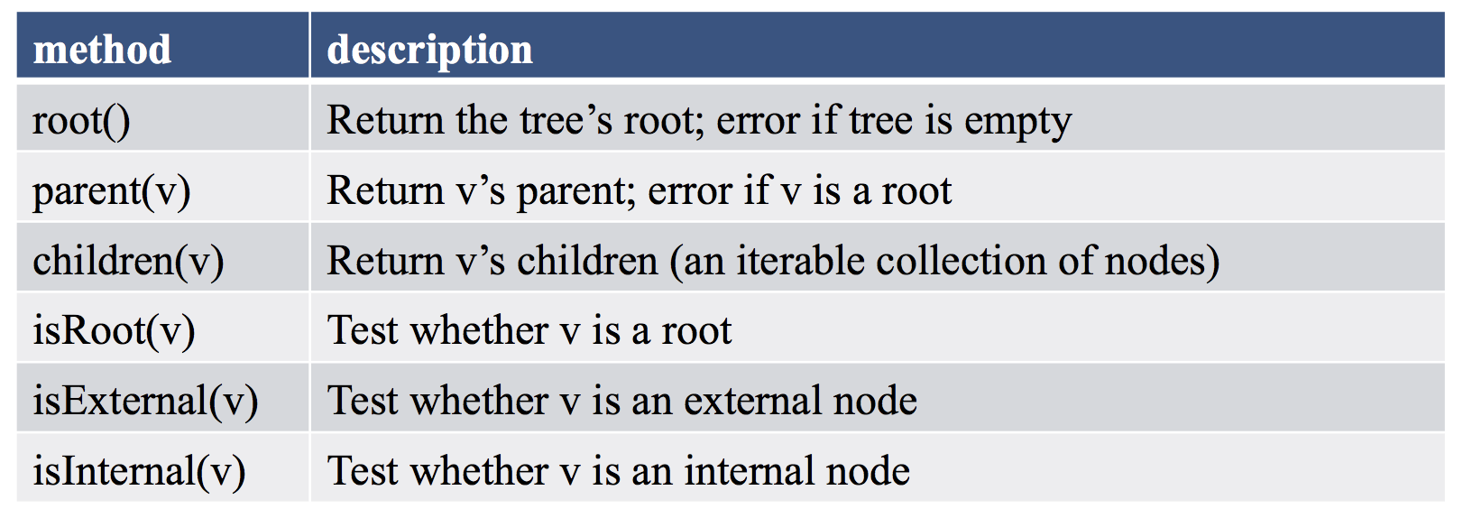
Tree ADT
We use positions to define the tree ADT
The positions in a tree are its nodes and neighboring positions satisfy the parent-child relationships

Slide 9
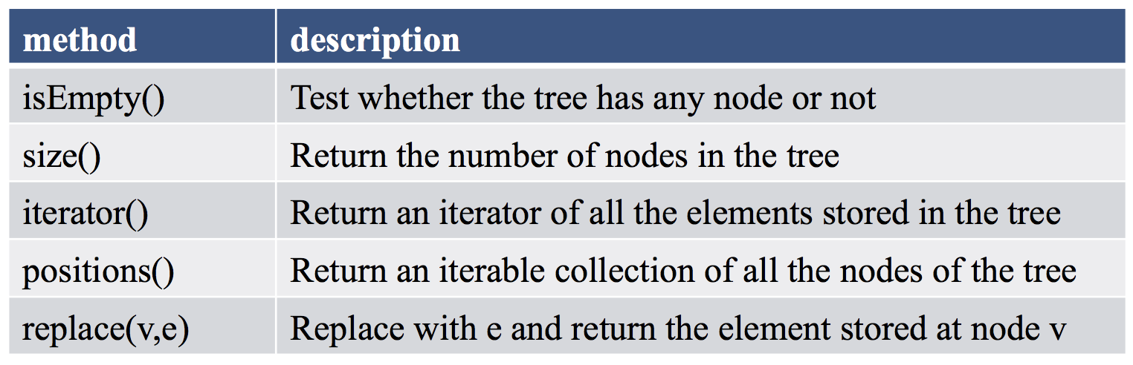
Tree ADT
Generic methods (not necessarily related to a tree structure):

Slide 10
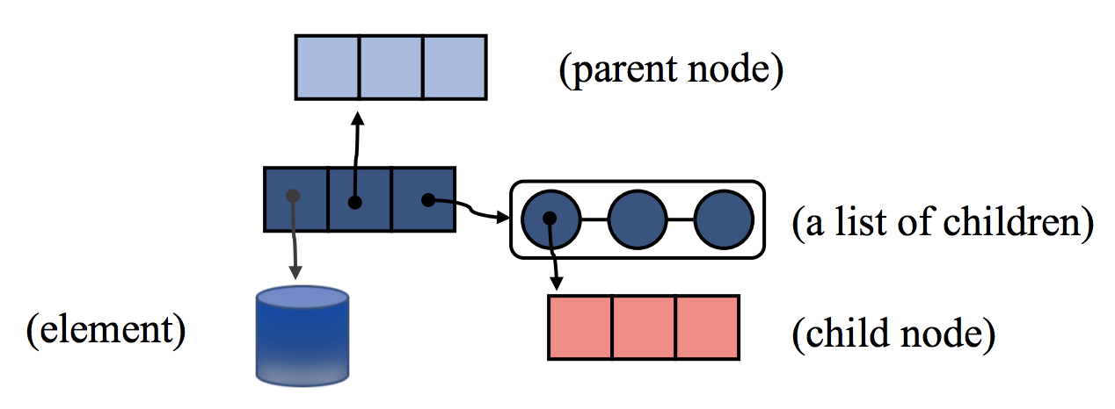
Linked Structure for Trees
A node is represented by an object storing
Element
Parent node
Sequence of children nodes

Slide 11
Linked Structure for Trees
Node objects implement the Position ADT
∅
B
∅
∅
B
A
D
F
A
D
F
C
E
∅
∅
C
E

Slide 12
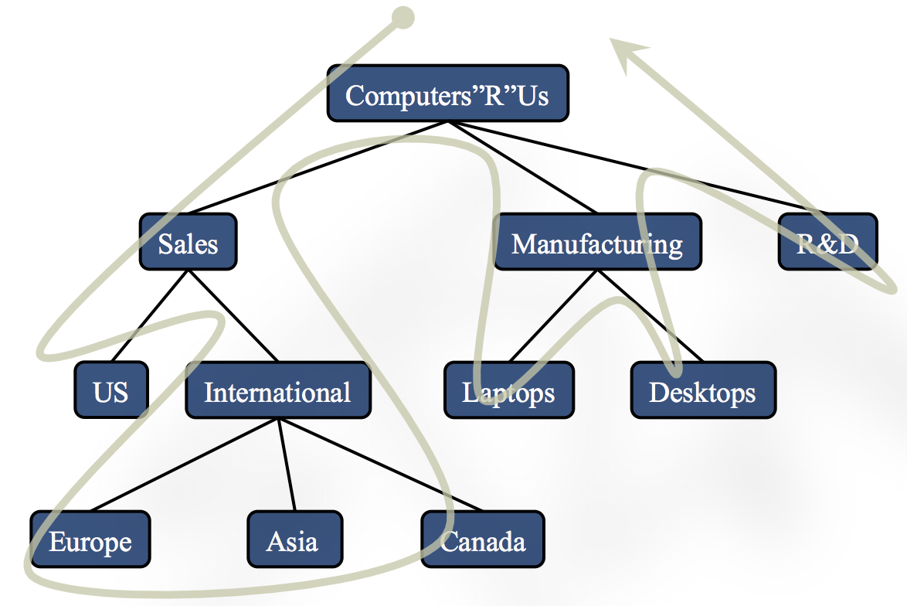
Tree Traversal
Visit all nodes in a tree
Perform some operations during the visit

Slide 13
Preorder Traversal
In a preorder traversal, a node is visited before its descendants
Application: print a structured document
Algorithm preOrder(v)
visit(v)
for each child w of v
preorder (w)
1
Make Money Fast!
2
5
9
1. Motivations
2. Methods
References
3
4
6
7
8
1.1 Greed
1.2 Avidity
2.1 Stock Fraud
2.2 Ponzi Scheme
2.3 Bank Robbery

Slide 14
Postorder Traversal
In a postorder traversal, a node is visited after its descendants
Application: compute space used by files in a directory and its subdirectories
Algorithm postOrder(v)
for each child w of v
postOrder (w)
visit(v)
9
cs16/
8
3
7
homeworks/
programs/
todo.txt 1K
1
2
4
5
6
h1c.doc 3K
h1nc.doc 2K
DDR.java 10K
Stocks.java 25K
Robot.java 20K

Slide 15
Binary Trees
A binary tree is a tree with the following properties:
Each internal node has at most two children.
The children of a node are an ordered pair
We call the children of an internal node left child and right child
Applications:
arithmetic expressions
decision processes
searching
A
B
C
D
E
F
G
H
I

Slide 16
Binary Trees
Alternative recursive definition: a binary tree is either
a tree consisting of a single node, or
a tree whose root has an ordered pair of children, each of which is a binary tree
A
B
C
D
E
F
G
H
I

Slide 17
Arithmetic Expression Tree
Binary tree associated with an arithmetic expression
internal nodes: operators
external nodes: operands
Example: arithmetic expression tree for the expression (2 × (a − 1) + (3 × b))
+
×
×
2
−
3
b
a
1

Slide 18
Decision Tree
Binary tree associated with a decision process
internal nodes: questions with yes/no answer
external nodes: decisions
Example: dining decision
Want a fast meal?
Yes
No
How about coffee?
On expense account?
Yes
No
Yes
No
Starbucks
Chipotle
Gracie’s
Café Paragon

Slide 19
Proper Binary Trees
Each internal node has exactly 2 children

Slide 20
Properties of Proper Binary Trees
Notation
n number of nodes
e number of external nodes
i number of internal nodes
h height(maximum depth of a node)
Properties:
e = i + 1
n = 2e − 1
h ≤ i
h ≤ (n − 1)/2
e ≤ 2^{h}
h ≥ log₂ e
h ≥ log₂ (n + 1) − 1

Slide 21
Properties of Proper Binary Trees
Properties:
e = i + 1
n = e+i = 2e – 1 = 2i + 1

Slide 22
Properties of Proper Binary Trees
Properties:
h ≤ i
h ≤ (n − 1)/2

Slide 23
Properties of Proper Binary Trees
Properties:
e ≤ 2^{h}
h ≥ log₂ e
h ≥ log₂ (n + 1) − 1

Slide 24
BinaryTree ADT
The BinaryTree ADT extends the Tree ADT, i.e., it inherits all the methods of the Tree ADT
Additional methods:
position left(p)
position right(p)
position sibling(p)
The above methods return null when there is no left, right, or sibling of p, respectively
Update methods may be defined by data structures implementing the BinaryTree ADT

Slide 25
Inorder Traversal of a Binary Tree
In an inorder traversal a node is visited after its left subtree and before its right subtree
Application: draw a binary tree
x(v) = inorder rank of v
y(v) = depth of v
Algorithm inOrder(v)
if left (v) ≠ null
inOrder (left (v))
visit(v)
if right(v) ≠ null
inOrder (right (v))
6
2
8
1
4
7
9
3
5

Slide 26
Print Arithmetic Expressions
Specialization of an inorder traversal
print operand or operator when visiting node
print “(“ before traversing left subtree
print “)“ after traversing right subtree
Algorithm printExpression(v)
if left (v) ≠ null print(“(’’)
printExpression (left(v))
print(v.element ())
if right(v) ≠ null
printExpression(right(v))
print (“)’’)
+
×
×
2
−
3
b
((2 × (a − 1)) + (3 × b))
a
1

Slide 27
Evaluate Arithmetic Expressions
Specialization of a postorder traversal
recursive method returning the value of a subtree
when visiting an internal node, combine the values of the subtrees
Algorithm evalExpr(v)
if isExternal (v)
return v.element ()
else
x ← evalExpr(left(v))
y ← evalExpr(right(v))
◊ ← operator stored at v
return x ◊ y
+
×
×
2
−
3
2
5
1

Slide 28
Euler Tour Traversal
Generic traversal of a binary tree
Includes special cases the preorder, postorder and inorder traversals
Walk around the tree and visit each edge twice (visit each internal node three times):
on the left (preorder)
from below (inorder)
on the right (postorder)
+
L
×
R
×
B
2
−
3
2
5
1

Slide 29
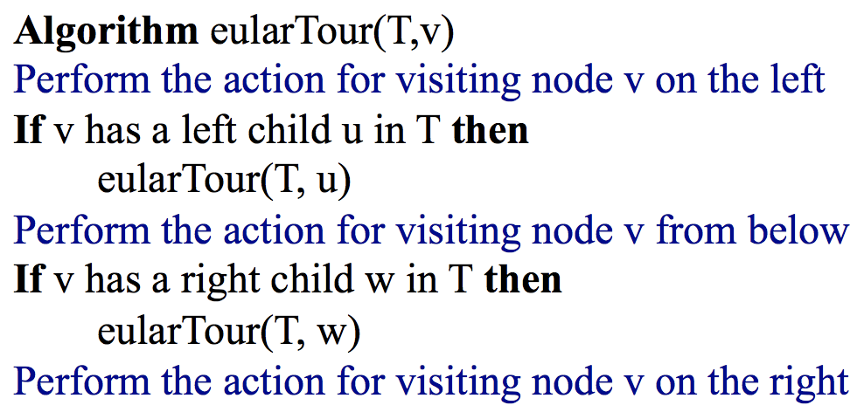
A template method pattern
A generic computation mechanism for Binary Trees
Specialized for an application by redefining the visit actions

Slide 30
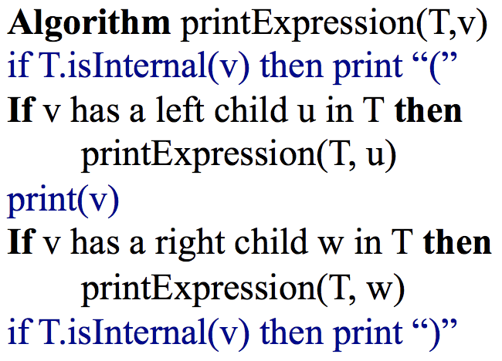
An application of EularTour
printExpression
On the left action: print (
From below action: print v
On the right action: print )

Slide 31
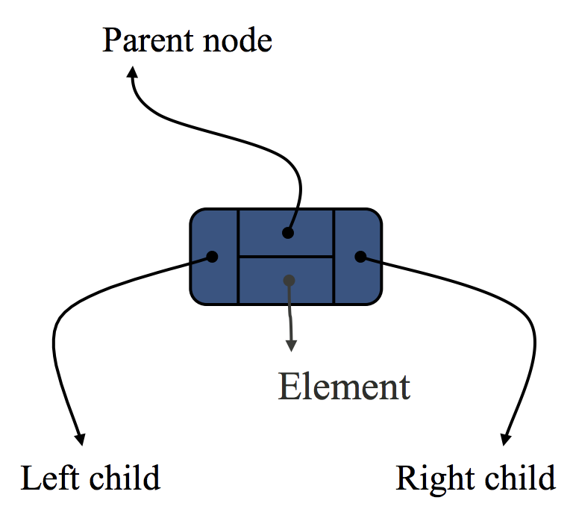
Linked Structure for Binary Trees
A node is represented by an object storing
Element
Parent node
Left child node
Right child node

Slide 32
Linked Structure for Binary Trees
Node objects implement the Position ADT
∅
B
∅
∅
B
A
D
A
D
∅
∅
∅
∅
C
E
C
E

Slide 33
Array-Based Representation of Binary Trees
Nodes are stored in an array X
0
A
A
B
D
…
G
H
…
1
2
0
1
2
9
10
B
D
Node v is stored at X[rank(v)]
rank(root) = 0
if node is the left child of parent(node), rank(node) = 2 ⋅ rank(parent(node)) + 1
if node is the right child of parent(node), rank(node) = 2 ⋅ rank(parent(node)) + 2
3
4
5
6
E
F
C
J
9
10
G
H

